Slide 1
Exception Handling
Abdul Haseeb

Slide 2
Exception Fundamentals
Exception:
Abnormal condition in a code sequence, which arises at run-time
Run Time Error
Disrupts the normal flow of program

Slide 3
Exception Fundamentals
Some programming languages doesn’t provide exception handling
Manually handle
Java provides exception handling

Slide 4
Exception Fundamentals
Java Exception:
Object
Describes error/exception, which has occurred in the code.
What happens when an exception arises?
Object related to that exception is created
Exception is caught at some point

Slide 5
Exception Fundamentals
Java Exception:
Exception can be generated by your code
Represent an error in your code
Can also be generated by JVM:
When you violate the rules of java execution environment
ArrayIndex out of Bound

Slide 6
Keywords
try:
Contains code to be checked for an exception, and is thrown
catch:
thrown Exception is caught and handled
throw:
Manually throw an exception
throws:
If exception is thrown, outside of the method, use throws
finally:
After try block completes, any block that must be executed after it, is placed in finally block

Slide 7
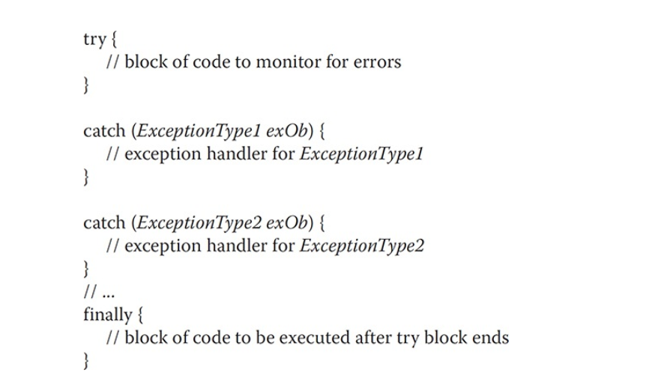

Slide 8
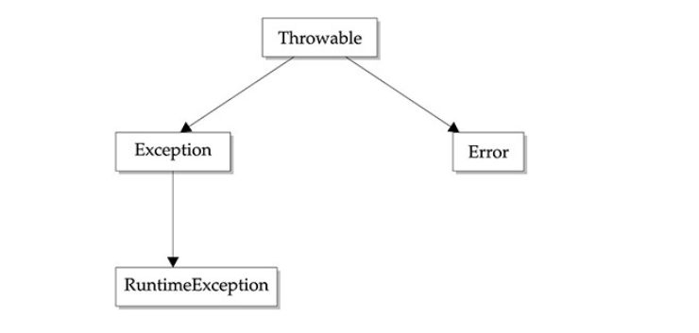
Hierarchy

Slide 9
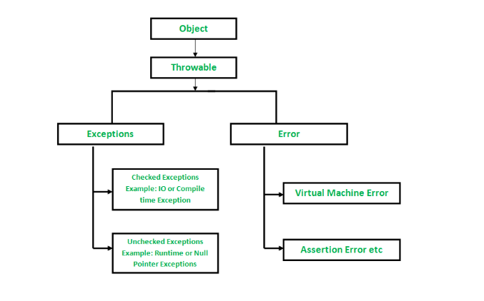
Hierarchy

Slide 10
Checked vs Unchecked Exception
Checked Exceptions occur frequently and JVM is very careful:
IO, Interrupt and SQLException
Unchecked Exceptions rarely, JVM not that much careful:
Run Time Exception like: Arithmetic, Null Pointer Exception etc
Error: Stack Overflow etc

Slide 11
Exception vs Error
Exception:
Type of conditions that user program must handle
Error:
Exceptions that are not expected to be caught under normal circumstances
Indicate issues with java run-time environment, lack of resources:
Stack overflow
Memory crashes

Slide 12
Uncaught Exceptions
Lets see what happens if we don’t provide exception handling code
Lets attempt division by zero
Caught by Run-Time

Slide 13
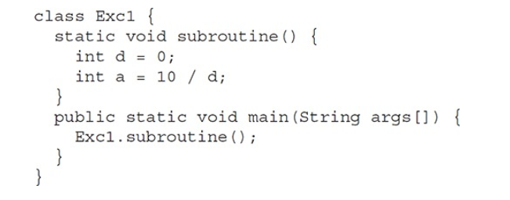
Stack Trace, Complete Record that from where the error Originated

Slide 14
Using Try-Catch
Java Run-Time was handling exceptions
But Handling Exception by yourself has advantages:
Prevents program from automatically terminating
It allows us to fix the error

Slide 15
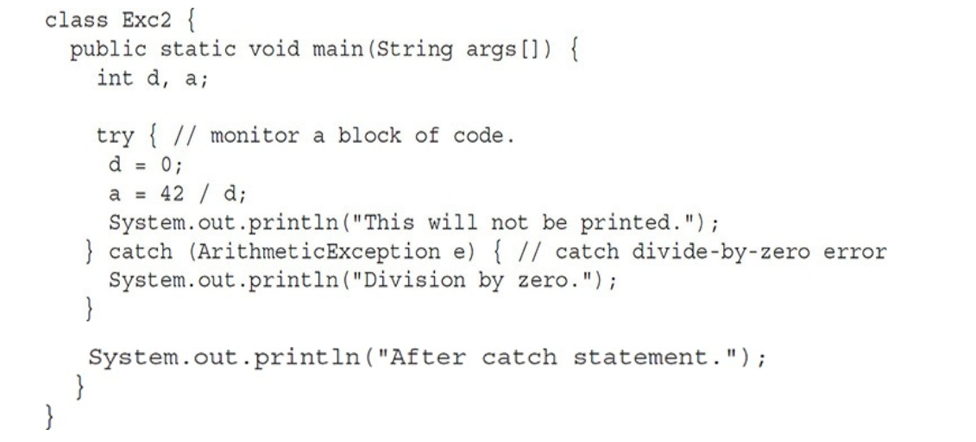
Try this Code!

Slide 16
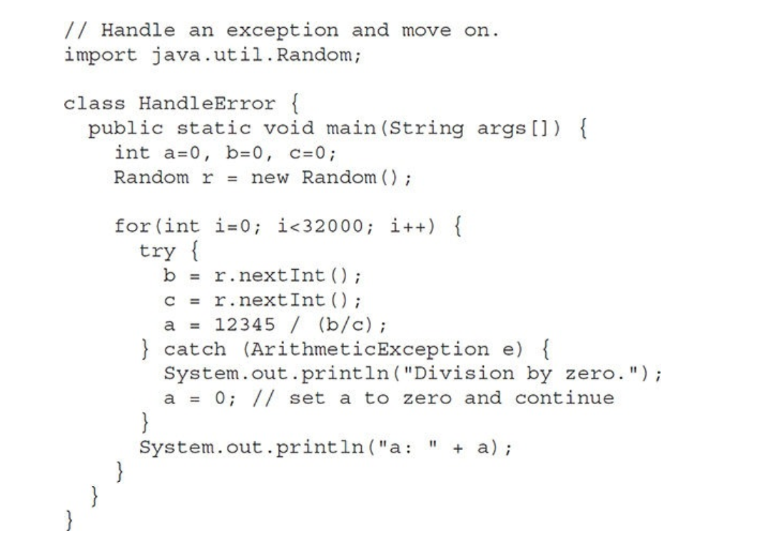
Another Example

Slide 17
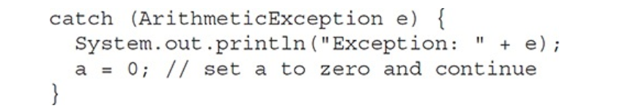
Description of an exception

Slide 18
Multiple Catch Blocks
In some cases more than one exception, caused by a single piece of code
Uses Multiple catch blocks,one for each kind of exception
After occurrence of exceptions:
Catch blocks are examined in sequence
After one executes, others are bypassed

Slide 19
Division by Zero, Array Index out of Bound example
Take integer input from user, using that input divide the number, (Zero or non zero)
Try to access an element outside the range

Slide 20
Multiple Catch Blocks
When using multiple catch blocks:
Make sure that subclass exception must precede the superclass exception, otherwise it will create unreachable code (Compile Time Error)
Because a superclass is aware of its children

Slide 21
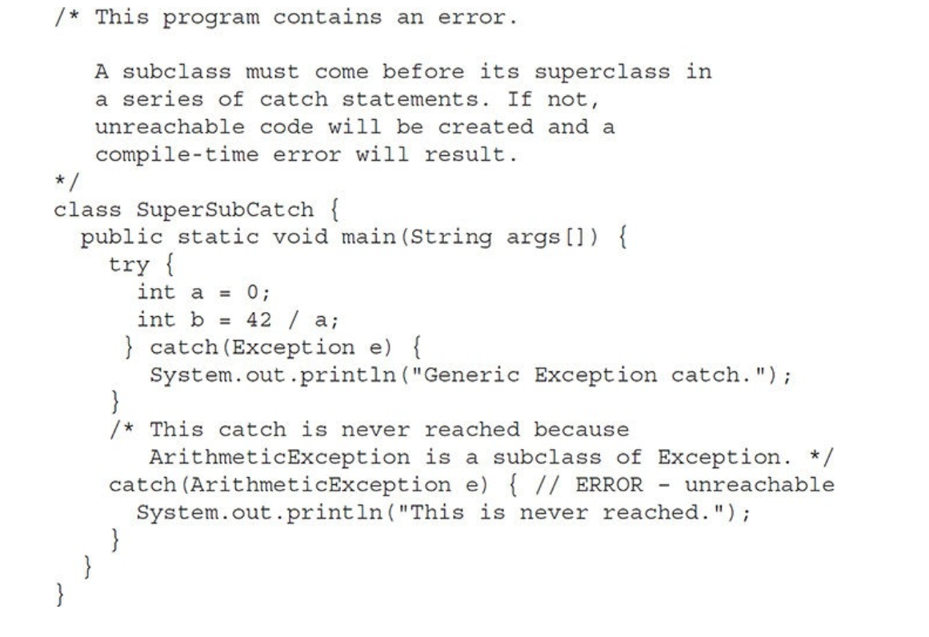

Slide 22
Throws
If method is capable of causing an exception/exceptions that it doesn’t handle
It then tells that I may cause an exception
It tells that with throws clause
Callers of methods must guard themselves:
Put that method in try block while calling

Slide 24
Throws
Create static method divide, accepting two arguments
Use throws to show it may throw Arithmetic Exception

Slide 25
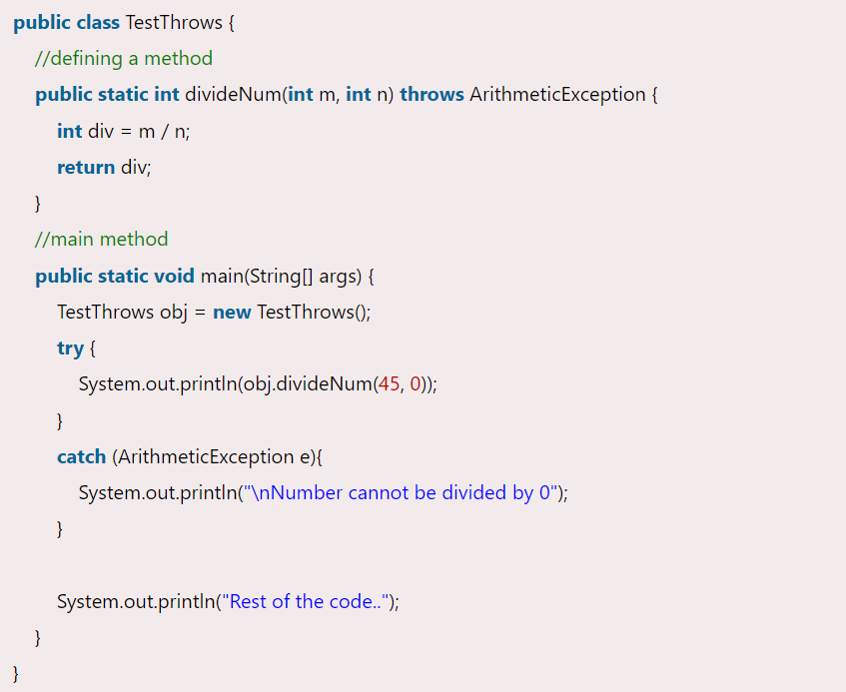

Slide 26
Throw
Used to throw an exception explicitly by a programmer
We throw an exception inside method, so that caller of method is shown with:
Which type of exception must be handled.

Slide 27
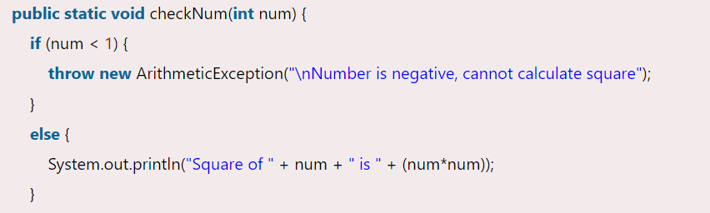
Throw

Slide 28
Throw and Throws

Slide 29
Finally
After a try catch block has completed execution, finally can be executed
Finally will always execute even if exception isn’t caught
Finally block is optional
Try block requires at least one catch block
If we omit catch block then we should give a finally

Slide 30
Java’s Built in Exceptions
Available in java.lang
Check out from the book

Slide 31
Assignment
Find out how can you create your own exceptions

